Slide 1
Variable Selection
Rutgers Statistics Club
Rutgers Cognitive Science Club

Slide 2
1.
So far...
We have learned how to do linear regression over multiple independent variables...

Slide 3
1.
BUT!
Let’s say we have 10, 20, 100, 1000 variables to choose from. Which ones will give us the best model?

Slide 4
Three Main Ways To Make a Better Model With Less Data
Subset Selection
Shrinkage
Dimensionality Reduction
This lesson will focus on the first two.

Slide 5
Subset Selection
The most straightforward way to reduce the complexity of our model would be to simply get rid of different variables, make the model with each set of new variables, and see which model performs the best.
How do we choose which to remove?

Slide 6
Best Subset Selection
Say our original dataset has k features
Look at all possible choices of 1 feature, then 2 features, …, then k features.
Make a new model for each and choose the best out of each set of 1-feature, 2-feature, …, k-feature models by the one that most minimizes RSS
Then, from each one of the 1-feature, 2-feature, …, k-feature models choose the absolute “best” one

Slide 7
Best Subset Selection: A Visual
K = 4 Features
Min RSS
Min RSS
Min RSS
Min RSS
M1
M2
M3
M4
M_{final}

Slide 8
Best Subset Selection
This is the absolutely most naive approach.
Drawbacks-
2^{k} models we have to run- computationally infeasible for large k
e.g. 2¹⁰ = 1024, 2¹⁵ = 32768, 2²⁰ = 1048576
Most models will be “bad” and so maybe we can do better and look at fewer models
May find models that perform very well on the training data, but badly on other testing data- overfitting

Slide 9
Stepwise Subset Selection: Forward
Instead of looking at all possible combinations of 1, 2, …, k-feature models, first start with a 0-feature model.
Then find the next most significant feature by adding all remaining features one at a time to find which one minimizes RSS (other procedures use p-values, R², or a different metric from RSS for significance of features)
Do this over and over and choose the “best” model
Called Forward Stepwise Selection

Slide 10
Forward Stepwise Subset Selection: A Visual
K = 4 Features
Min RSS
Min RSS
Min RSS
Min RSS
M1
M2
M3
M4
M_{final}

Slide 11
Stepwise Subset Selection: Backward
Similarly, we can start with a k-feature model and remove the least significant variable each time (as we mentioned for Forward, multiple approaches determine this differently, but we will use RSS)
This is called Backward Stepwise Selection (sometimes called Backward Elimination)

Slide 12
Backward Stepwise Subset Selection: A Visual
K = 4 Features
Min RSS
Min RSS
Min RSS
Min RSS
M4
M3
M2
M1
M_{final}

Slide 13
Backward vs Forward Stepwise Subset Selection
Backward Stepwise Subset Selection may not choose the same variables as Forward Stepwise Subset Selection
NOTE: Backward Stepwise only works when you have the number of samples, n, larger than k. However Forward Stepwise works even when n < k.
You may sometimes see a hybrid of Forward and Backward Stepwise Selection being used.

Slide 14
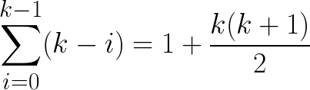
Stepwise Subset Selection: Analysis
Analysis: Whereas Best Subset Selection ran 2^{k} models, for Forwards and Backwards , we only run
models (much fewer!)
Drawback
By not looking at as many models as Best Subset Selection, we ignore some models that may be better.
But odds are that we will still find a very good model that will not overfit or take very long to compute.
e.g. 1 + 10(10+1)/2 = 56,
1 + 20(20+1)/2 = 211

Slide 15
What Does “Best” Really Mean?
Once we have one model for each number of features, how do we decide which is best?

Slide 16
Choosing The Optimal Model
Why not just use RSS?
The more features we add, the more risk of an overfit in the model
This means that we need to penalize the addition of more variables for each step
2 Main Methods (There are of course others):
Use model accuracy metrics such as AIC, Mallow’s C_{p}, BIC, Adjusted R², and PRESS
Cross Validation (e.g. 10-fold)

Slide 17
Adjusting For Test Error
RSS, our metric for error, gets smaller and smaller as we add more variables. As # of features increases we will fit to our training data better and better
Unfortunately, this will eventually overfit to training data and not perform as well on test data (new data).
One approach is to derive a formula that predict how much test error we get for adding more variables

Slide 18

An Important Value
RSS_{k} = the minimum RSS over all models
m = number of datapoints in our training set
k = total number of features
Note that even though RSS_{k} gets smaller as number of features increases, denominator (m-k-1) also gets smaller. This means that estimated variance of error also increases!

Slide 19

How do We Use this Value
All following equations will basically have a term of the form:
NOTE: This RSS is taken for the current model (not the full k-feature model like RSS_{k}).
As we include more features, RSS will decrease. To offset this, add the number of features (d) times the increase in variance of error per feature. This estimates how much the variance in error increases for d features

Slide 20



C_{p}, AIC, and BIC
To choose the optimal model, first select either C_{p}, AIC, or BIC criterion
Then choose model that has minimum value of estimate

Slide 21


A Note on Adjusted R²
Similar to how RSS decreases for more features, R² increases for more features
Adjusted R² accounts for this in a similar way to how we use in C_{p}, AIC, and BIC
Instead of choosing the minimum like in C_{p}, AIC, or BIC, we choose the model with maximum adjusted R²

Slide 22
If We Really Want Test Error...
… then why not just calculate test error, Cross Validation

Slide 23
Cross Validation
In the past, it was way too expensive to actually test every model on the test data and compute the error, which is why we have estimates like C_{p}, AIC, BIC, etc.
Nowadays, we have the computing power to examine how each model performs on test data and compare their errors. This is called Cross Validation!

Slide 24
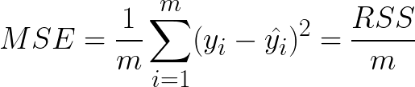
What is the Test Error
Once you have trained your model, you now need to test your model on the test data and compute some measure of error
A common measure of this is Mean Squared Error
where m = number of datapoints in the test data.
Dividing by m allows us to compare the errors even if they have different testing data and/or # of points

Slide 25
K-Folds Cross Validation
It is important to ensure that it wasn’t just some arbitrary choice of split for training and testing data that dictated our model construction and test error
We want to be sure that our model works well on multiple splits of the data
K-Folds has an approach to achieve this

Slide 26
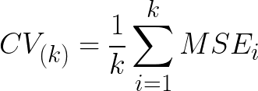
K-Folds Cross Validation
For K-Folds, split the data into k (not the same k as number of features) equal pieces. Then for i = 1 … k:
Choose data block i as your test data
Choose all other blocks as your training data to build the model
Compute MSE_{i} of the model on testing data
Then average all MSE_{i} :
As we increase k, our estimate of our testing error decreases in bias (commonly k = 10)
However, this is computationally expensive!
Other methods offer less computation.

Slide 27
The Takeaway On Cross Validation
In practice, cross validation is one of the most commonly used tools to measure the performance of any model
We can use it instead of C_{p}, BIC, and AIC as an estimate of test error as we increase the number of features to select variables
However, it has many uses beyond that (one of which we will see soon.)

Slide 28
Important Info on Subset Selection
Previous 3 forms of subset selection are basic ones.
If you are interested in a more advanced approach to subset selection, take a look at the leaps (or lars) function. However, this sort of deeper functionality is not natively available in Python, but can be found in languages such as R.

Slide 29
Problems with Subset Selection
NOTE that many authors argue that many of the assumptions that allow for stepwise selection are faulty and can often be violated. See https://towardsdatascience.com/stopping-stepwise-why-stepwise-selection-is-bad-and-what-you-should-use-instead-90818b3f52df
The author of the above article even comments “for a data analyst to use stepwise methods is equivalent to telling his or her boss that his or her salary should be cut.”
Subset selection may also simply still take too long on really large numbers of features

Slide 30
Enter the Modern Approach- Shrinkage
What if, instead of fully removing variables, we simply reduced the influence of the least significant ones?

Slide 31
Shrinkage (AKA Regularization)
Shrinkage, also known as Regularization, is a way of penalizing overfitting to training data
We do this by adding some term that will increase RSS (decrease model fitness), the greater our coefficients, 𝝱₁, 𝝱₂, .. 𝝱_{k}, are.
From bias-variance perspective, the more we penalize the weights of our features, the more we minimize bias and variance of test error

Slide 32
The Form of Shrinkage Formulas
The shrinkage formulas are just modifications of our cost function. Initially, cost function was just to minimize the sum of squared residuals (in other words RSS)
This means that for shrinkage, we would like to minimize that plus some combination of the regression coefficients

Slide 33
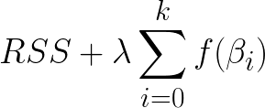

The Form of Shrinkage Formulas
Therefore, common shrinkage formulas all follow the form:
tells us how badly we will penalize high values of the coefficients (sometimes changed to )
is some function applied to the coefficients to ensure they all contribute positively to the penalty (similar to why we square in RSS).

Slide 34
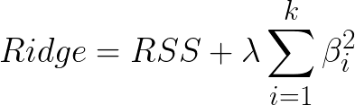
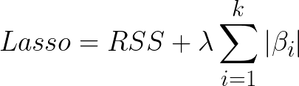
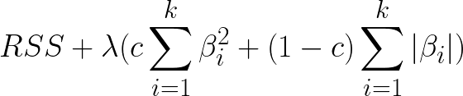
Ridge, Lasso, and Elasticnet Regression
Ridge Cost Function:
Lasso Cost Function:
Elasticnet Cost Function:

Slide 35
Facts About Shrinkage
As your penalty parameter, , increases you are minimizing test error.
However, you are also increasing RSS because the penalty tries to avoid fitting too much to the test data.
If is too large, we may risk underfitting and having an oversimplified model

Slide 36
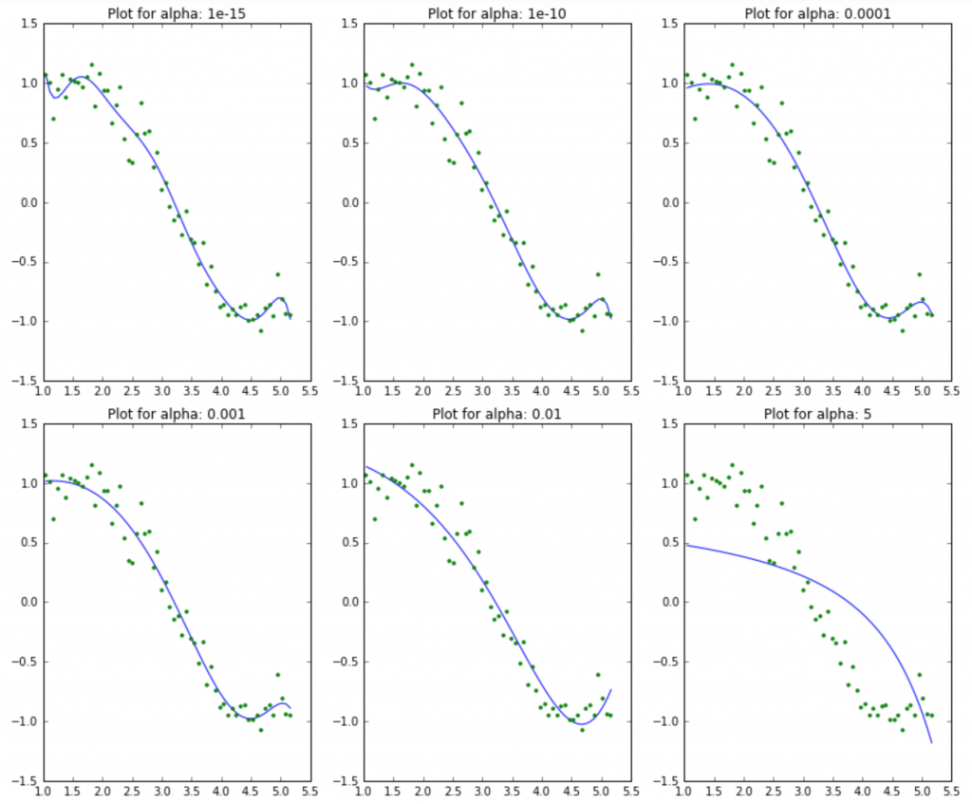
An Example of Shrinkage
Note author decided to call lambda value “alpha”
What we have not addressed yet is how to find the optimal weight, to penalty term. To the right is a demonstration of shrinkage applied to a regression model with multiple values of the lambda term.
Image taken from: https://www.analyticsvidhya.com/blog/2016/01/complete-tutorial-ridge-lasso-regression-python/

Slide 37
How Do We Choose The Best Lambda?
In theory, you could mess around with a bunch of values of until satisfied
But, for a more statistically rigorous approach (the one you should do):
Start by running the model for a set of different lambdas at diverse values
Compute cross validation error (e.g. k-folds) for each and pick one that yields minimum error

Slide 38
Aside on Dimensionality Reduction
If anyone is interested in dimensionality reduction, it is highly suggested to look into Principal Component Analysis (PCA), which is covered both in Introduction to Statistical Learning with Applications in R at the end of Chapter 6 and also in many online resources.

